Slide 1


Interviewing for Fit and Potential

Slide 2
Agenda ...
Familiarize you with the 5-step structured Selection & Interview Process
Preparation
Structured Interview Process
2. Setting the scene
3. Asking Competency Based Behaviour Questions
4. Close & Next Steps
5. Rating the Candidate

Slide 3

“Setting the bar high in our approach to hiring has been, and will continue to be, the single most important element of [our] success.”
Jeff Bezos CEO Amazon
1998
Notes:
Trainer’s notes
“Don’t just take my word that hiring matters. This business person thinks so too.”
“What’s especially impressive is when Jeff Bezos said this: 1998”
“The company only went public in 1997 at $18 a share.”
“Great hiring has obviously been integral to Amazon’s success.”
“Their share price is around $1,900 today (July 2019).”

Slide 4
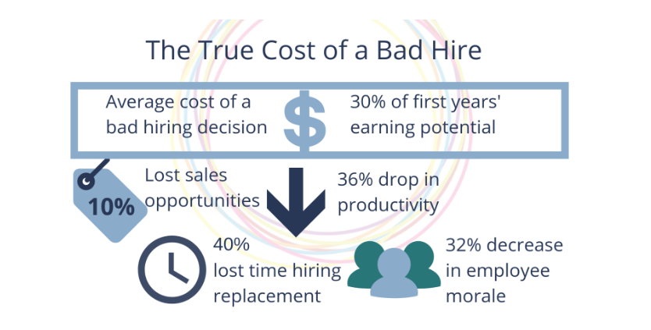

It is estimated that a bad hire can cost a company at least 30% of the employee's annual salary, depending on position, seniority, industry

Slide 5




A bad hire doesn’t mean a bad person…it means the candidate was not a fit for the role or the team!

Slide 6
Let’s now look at which of the following selection methods have high and low predictability of selecting the right candidate
Resume
References & Recommendations
assessment center
Educational background
mental ability
Gut Feelings
Previous experience for competitors
Knowledge based questions

Slide 7
Low Predictability | High Predictability
Resume | Structured Interview
References & Recommendations | Assessment Centre
Educational Background | Psychometric assessments
Unstructured interview | Behavior based questions
Gut Feelings
Knowledge based questions

Slide 8
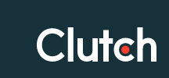


91% of people say their view of a company is influenced by the interview process, and people are 6 times more likely to tell others if they have a negative experience.
‘A candidate-driven market’ is that strong candidates have multiple options
The interview process is not just the candidates’ means of representing themselves to the company, but the company’s way of representing themselves to the candidate…and more than that – to the wider world too.

Slide 9

Begin the 5 Steps to structured Selection & Interview process
Preparation
Structured interview process
2. Setting the scene
3. Asking Competency Based Behaviour Questions
4. Close & Next Steps
5. Rating the Candidate

Slide 10

Before you begin the structured interview process…
Reviewed the CV & Job description
What is the success profile of the candidate for the role?
Key deliverables and 3 key priorities
Define which competencies are going to be most critical for the role Technical & Behavioural
Write down the questions you would like to ask.
Have your interview feedback form/ system ready to capture observations.

Slide 11

Preparation
Structured interview process
2. Setting the scene
3. Asking Competency Based Behaviour Questions
4. Close & Next Steps
5. Rating the Candidate

Slide 12


Be on time & Give a warm welcome
Be in a positive frame of mind, smile and meet in an inviting space. Offer a beverage.
Silent mode or Turn off Your phone.
Help the candidate settle. “How was Your journey.” “I know that school.” “Working there must have been fun.” etc.
Explain the interview process, and what they should expect during the interview.
Briefly introduce Al-Futtaim, the division and the role before asking questions.
Setting the Scene
Give the candidate your undivided attention

Slide 13

Preparation
Structured interview process
2. Setting the scene
3. Asking Competency Based Behaviour Questions
4. Close & Next Steps
5. Rating the Candidate

Slide 14
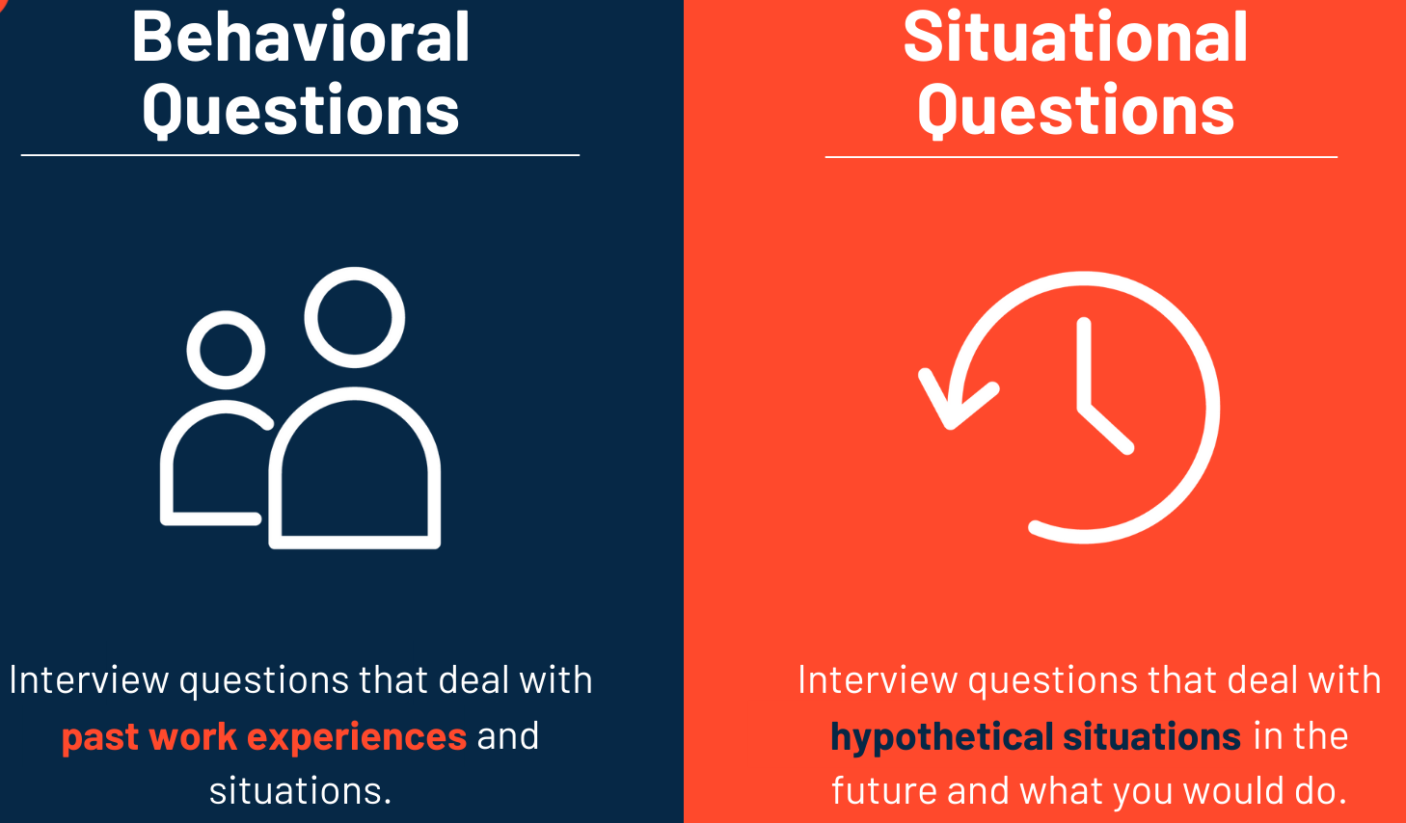
Behavioral Based Interviewing is built on the premise that past behavior predicts future behavior.
The Behavioral based Interview is a systematic way to understand how the candidate behaved in past specific situations.
It helps assess the likelihood for a candidate to be successful in the role based on information the candidate provides .
What is Behaviour-based Interviewing?

Slide 15
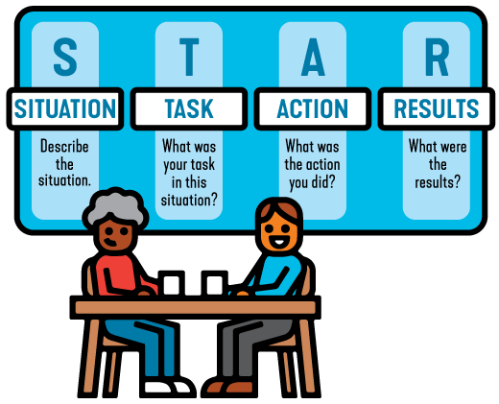
The STAR method is a technique used to prompt candidates to give specific examples of how they've handled past situations or challenges; using this method ensures we get objective responses that help us minimize gut feeling decisions and give us an insight on how the person thinks and how they apply themselves at work.
It also helps you drill down into the details, which help you gauge how authentic the candidate is being.
STAR Technique f Interviewing questions
Notes:
The STAR interview method is way to structure a behavior-based interview question, by asking the candidate the specific Situation, Task, Action, and Result of a previous experience or situation related to their job.

Slide 16
WHAT? | HOW?
What was your role? What did you do? What do you mean? What did that look like? What was the impact/result? What is a good example of that? What was your biggest mistake? What was your biggest failure? What targets did you miss? What did your boss say? What did your boss say when you announced your resignation? What motivated you? What about that was hard? What didn’t you enjoy doing? What parts of the job did you not like? What did you learn? | How did your performance compare to peers? How did your performance compare to the plan? How did your performance compare to the previous year’s performance? How did you do that? How did that go? How long did it take? How did that impact you? How did that impact the business? How did you feel? How much money did you save? How did you deal with that?” How could you have done that better? How did that person react? How did you communicate that?
Follow up Questions to Probe for details - Behavior Based Questions

Slide 17

Are you a team player?
Tell me about a time when you oversaw a task or project, describe your leadership style
We have a situation where the custom wants to access information digitally, how would you make that available?
What was your greatest challenge in a particular leadership role you have had?
What idea have you developed and implemented that was particularly creative or innovative?
What characteristics do you think are important for this position?
Which Qs are Behavior Based?

Slide 18
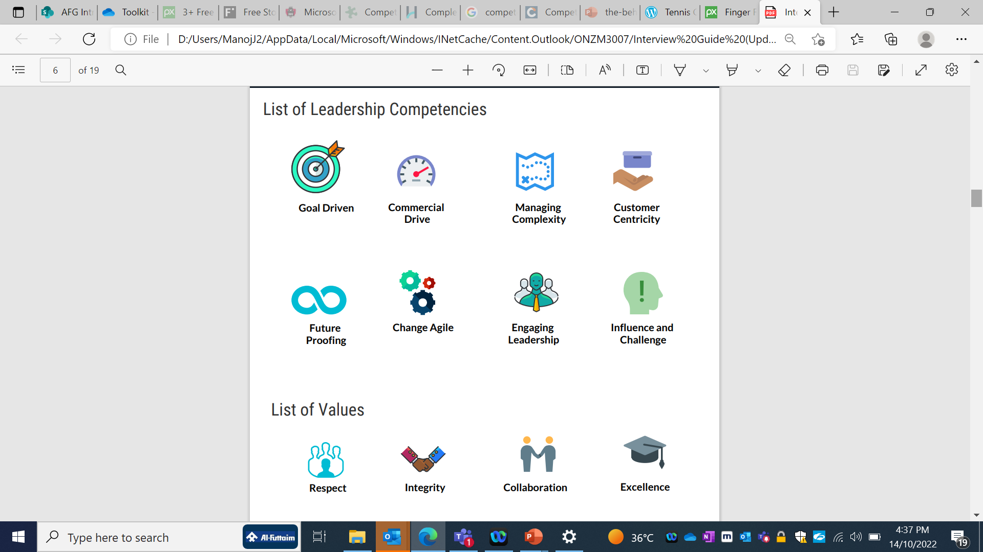
Prioritize which Competencies are critical for success, and ask questions to understand the behaviours the candidate would have demonstrated in the past around these competencies.
Always ask for a real NOT a hypothetical event.
E.g. Tell me about a time when you where challenged in influencing a key stakeholder.....
NOT
What would you do to influence a key stakeholder?
Values & Competency Based Assessment

Slide 19

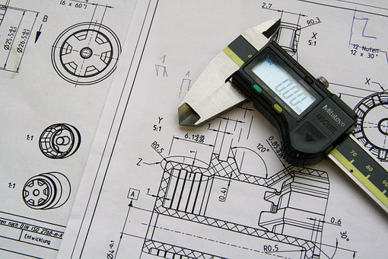

Similarly think about what technical capabilities are critical for success in this role.
Understand how the candidate approaches such tasks
E.g. Capability to operate under pressure
Go back to a time where you were accountable to deliver on a project, which was getting repeatedly delayed...or had an unexpected budget cut...how did you manage the situation
Technical Competency Based Assessment

Slide 20
The quality and quantity of responses are based on the type of questions you ask!
Closed
STAR QUESTIONS
Probe
Reconfirm

Slide 21


Interview questions to ask and not to ask
What kind of questions are you not allowed to ask
Questions around age, ethnicity, sexual orientation or religous beliefs
Questions about their future to becoming parents
Finacial status
Disabilities (unless their job requires physcial requirement )
None of the above
We beleive in asking open ended questions
What, How, Tell Me More.....
Ask for examples – encourage candidates to be specific!
Be interested – dig a little deeper, don‘t accept generic phrases
Don’t use your own judgement, actively listen
Allow for silence
Repeat back what the candidate has said to ensure you understand

Slide 22

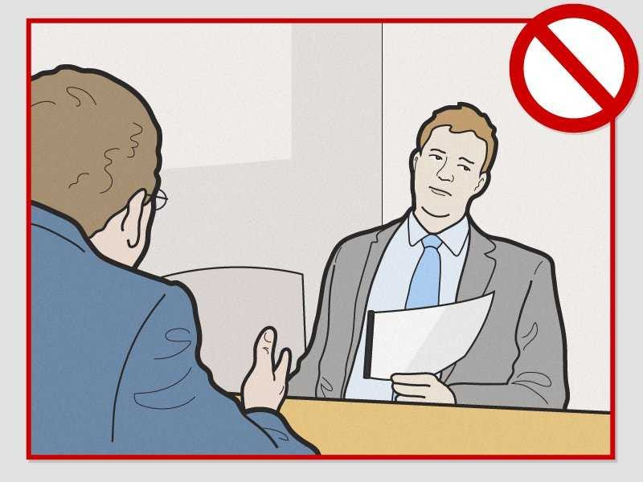
What interviewer distractions do candidates notice?
Doesn't maintain eye contact, Picks phone calls
Seems Distracted & has negative body language
Frequent interruptions, cut’s the interview short
Don’t listen & frequently ask the candidate to repeat
Don’t listen & frequently ask the candidate to repeat
Uses the incorrect resume & ask’s candidate’s name
Staring at Female candidates in-appropriately

Slide 23

Preparation
Structured interview process
2. Setting the scene
3. Asking Competency Based Behaviour Questions
4. Close & Next Steps
5. Rating the Candidate

Slide 24


Give time for the candidate to ask you any questions
Thank them for their time and interest in the job and Al-Futtaim as their potential employer
Brief the Candidate on the next steps.
Avoid Ghosting….If you say you would give them a call within a few days, then make sure you stick to it.
Close & Next Steps

Slide 25
Let’s summarize the 5 Steps of Interview Process
Preparation Review the CV & Job description
Key deliverables priorities
Define the competencies and write down the questions
Keep the interview feedback form ready
Setting the Scene (5-7mins)
Be on time & Give a warm welcome
Explain the interview process
Briefly introduce Al-Futtaim
Asking Competency based Behavior Based Questions (15-20mins)
Ask open ended questions using the STAR Methodology Focus on details , individual contribution
Close & Next Steps
Allow candidate time to ask questions
Don’t give feedback
Advice Next Steps Thank them for their time and interest
Rating the Candidate
5 – High evidence. 4 – Moderate to high evidence. 3 – Moderate evidence. 2 – Low to moderate evidence. 1 – Low evidence.
1
2
3
Structured Interview Process
5
4

Slide 26


Preparation
Structured interview process
2. Setting the scene
3. Asking Competency Based Behaviour Questions
4. Close & Next Steps
5. Rating the Candidate
Rating the Candidate

Slide 27

Complete the scoring sheet right after the interview
5 – High evidence.
4 – Moderate to high evidence.
3 – Moderate evidence.
2 – Low to moderate evidence.
1 – Low evidence.
Rating the Candidate

Slide 28
Get back to candidates quickly!

